Slide 1

SMARTSAUDA
A Real-Time Embedded System
Automated retail checkout designed for efficiency and simplicity

Slide 2

Prepared by:
M. Hammad Abdullah
Aiyan Sheryar
Shabia Sajjad
Waleed Nadeem
Supervisor:
Mr. Syed Noman Ali Shah
Co-Supervisor:
Mr. Asim Irshad

Slide 3


Problem Statement
Manual billing in local stores → long queues, errors, lack of real-time bill visibility.
Existing tech (RFID / vision) is costly or impractical locally.
Need: low-cost, accurate, real-time billing for supermarkets.

Slide 4
Proposed Solution
SmartSauda: Arduino-based smart cart with NFC, load-cell verification and QR pairing.
Real-time mobile app shows bill; central DB for product & transaction management.
Low cost, low power, offline sync capability.

Slide 5
High-Level Architecture
Sensor Layer:
NFC Reader + Load Cell
(Product Detection & Weight Verification)
Controller Layer:
Arduino (Core Logic)
ESP-01 (Wi-Fi Communication)
Connectivity Layer:
REST APIs
Cloud Synchronization
Application Layer:
Customer Mobile App
Admin Dashboard
Interaction Flow
Scan → Validate → Sync → Display

Slide 6
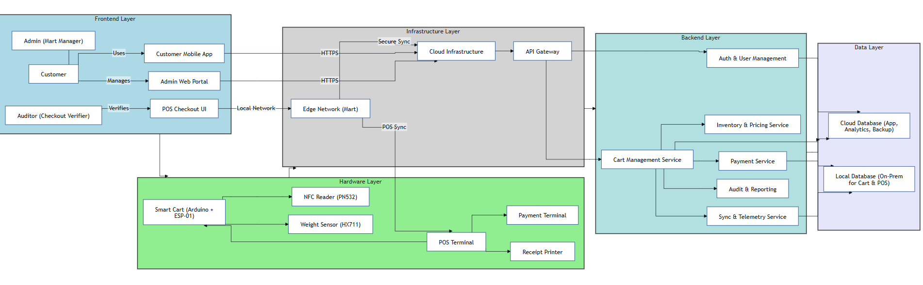
Architecture Diagram

Slide 7
Mobile Application
Built With
Flutter (Cross-Platform Mobile App)
👥 User Roles
• Customer
• Auditor
• Admin

Slide 8
- Customer Module
• QR-Based Cart Pairing
• NFC Item Scanning
• Barcode Scanning Support
• Live Bill View
• Product Details (Weight, Quantity, Price)
• Real-Time Total Calculation

Slide 9
- Auditor Module
• QR-Based Cart Access
• Bill Generation & Verification
• Payment Trigger Authorization
• Auditor Login Dashboard
• Audit Count Tracking
• Total Sales & Customers Handled

Slide 10
- Admin Module
• User Management (Customers & Auditors)
• Enable/Disable Specific Accounts
• Invoicing Monitoring & Filtering (Day/Month/Year)
• Dashboard: Total Sales, Active Users, Daily Invoices
• Inventory & Profit/Loss Analytics (Graph Based)

Slide 11
Mobile Application Demo

Slide 12
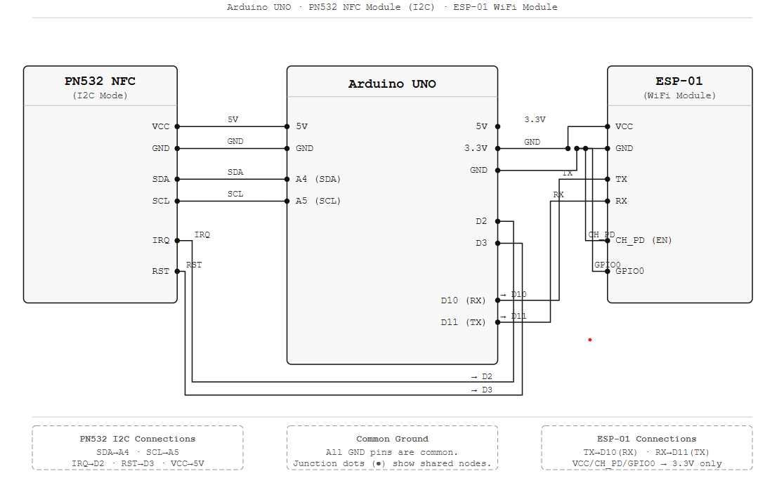
CIRCUIT DIAGRAM

Slide 13
Future Enhancements
• POS Integration
Direct billing integration with store counters
• Payment Gateway Integration
Support for cash, card, digital payments
• AI-Based Anti-Theft Monitoring
Camera-based suspicious activity detection
• Customer Loyalty & Reward System
Points based rewards for repeat customers.

Slide 14
SMARTSAUDA
Thankyou, Questions?

